Slide 1

Craft of Statistical Analysis
Steve Simon for
Notes:
Analyzing Repeated Measures Data Workshop: Module 5 The Linear Mixed Model
Copyright 2011 The Analysis Factor http://TheAnalysisFactor.com
1

Slide 2
Abstract
Craft of Statistical Analysis
Survival analysis is a collection of statistical tools that were developed to assist with mortality studies. A common feature of these survival analysis tools is the ability to include censored data, data from people who drop out during the study. These tools allow you to use the information from these censored observations to help estimate survival probabilities up to and including the day that they dropped out. Although survival models were originally developed for mortality events, you can adapt them to many other outcomes, such as customer churn, restaurant closings, defoliation of plants, and metal fatigue. The outcomes do not necessarily have to be “bad” events. Survival analysis is also useful for successful completion of training for guide dogs and time to pregnancy in couples with fertility problems.
In this talk you will see a variety of Kaplan-Meier curves, the fundamental graphical display for survival data and learn how to interpret these curves. You’ll also see the underlying calculations of a Kaplan-Meier curve and an advanced application of competing risks analysis using a Political Science example of duration of leadership in the world’s countries.

Slide 3


Slide 4
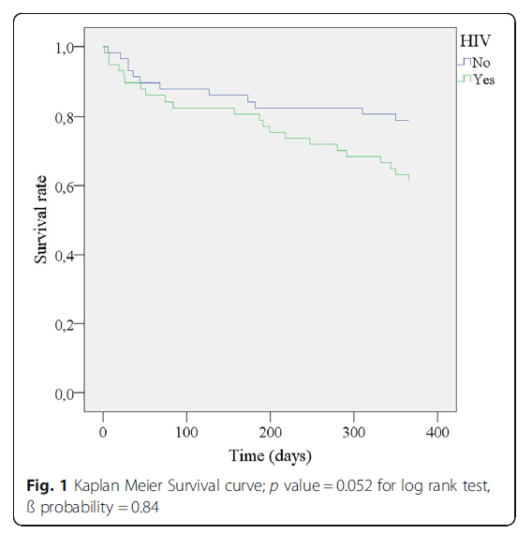

Slide 5


Slide 6
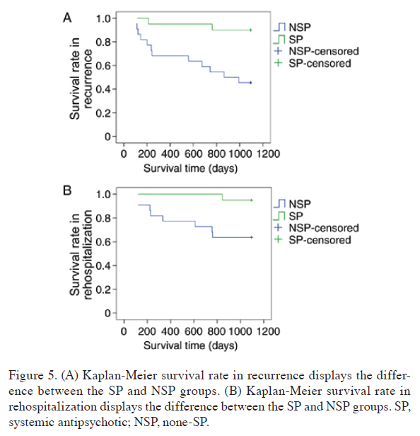

Slide 7


Slide 8
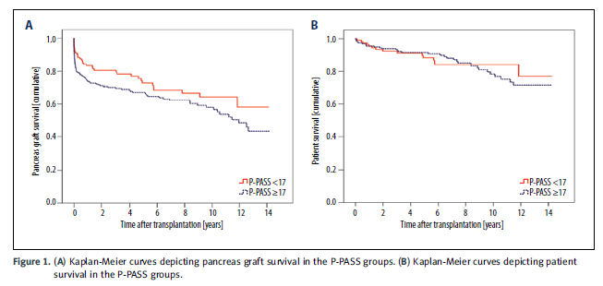

Slide 9


Slide 10
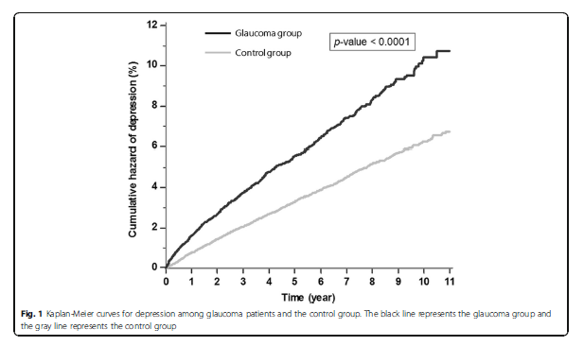

Slide 11


Slide 12
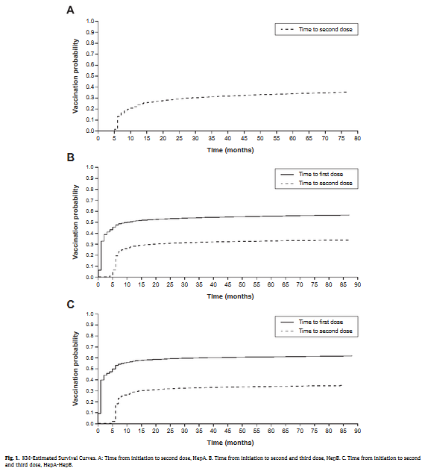

Slide 13


Slide 14
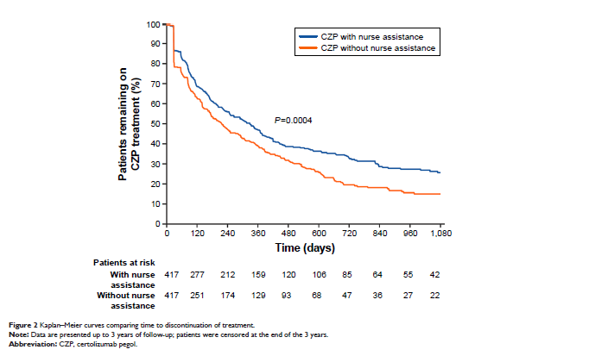

Slide 15
The leader data set
Overview
This data set tracks leaders of countries of the world and how long they stay in power. Leaders can be removed by constitutional means, by natural death, or by nonconstitutional means (military coup or assassination, for example). This data set is restricted to 1960 through 1987, and does not include North America.

Slide 16
The leader data set
Variables
years Min. 1st Qu. Median Mean 3rd Qu. Max.
0.000 1.000 3.000 5.114 7.000 27.000
lost still in power constitutional exit
111 146
natural death nonconstitutional exit
27 154

Slide 17
The leader data set
Variables
manner constitutional ascent
280
nonconstitutional ascent
158
start Min. 1st Qu. Median Mean 3rd Qu. Max.
1960 1965 1973 1973 1979 1987
military no yes
294 144

Slide 18
The leader data set
Variables
age Min. 1st Qu. Median Mean 3rd Qu. Max.
17.00 41.00 50.00 49.39 56.75 81.00
conflict low conflict medium/high conflict
166 272
loginc Min. 1st Qu. Median Mean 3rd Qu. Max.
4.094 5.075 5.858 5.916 6.565 9.546

Slide 19
The leader data set
Variables
growth Min. 1st Qu. Median Mean 3rd Qu. Max.
-7.00 0.50 1.50 1.63 3.40 8.50
pop Min. 1st Qu. Median Mean 3rd Qu. Max.
0.008 2.600 7.000 35.780 24.000 1088.000
Land Min. 1st Qu. Median Mean 3rd Qu. Max.
0.02 49.00 238.00 739.97 912.00 9596.00

Slide 20
The leader data set
Variables
literacy Min. 1st Qu. Median Mean 3rd Qu. Max.
5 32 65 59.41 85 99
region middle east africa
60 132
asia latin america
91 155

Slide 21
The leader data set
Check for sufficient number of events in each group
manner 0 1
constitutional ascent 70 210
nonconstitutional ascent 41 117
military 0 1
no 70 224
yes 41 103

Slide 22
The leader data set
Check for sufficient number of events in each group
conflict 0 1
low conflict 42 124
medium/high conflict 69 203
region 0 1
middle east 18 42
africa 42 90
asia 26 65
latin america 25 130

Slide 23
The leader data set
Create cut-points for continuous variables
start_c 60s 70s 80s
176 159 103
age_c 0-39 40-59 60+
89 265 84
loginc_c $0-200 $200-500 $500+
130 149 159

Slide 24
The leader data set
Create cut-points for continuous variables
growth_c neg 0-3.9% 4%+
85 275 78
pop_c under 1m 1-10m 10m+
70 189 179

Slide 25
The leader data set
Create cut-points for continuous variables
land_c under 100 sq km 98
100-1,000 sq km 142
1,000-10,000 sq km 198
literacy_c 0-50% 50-75% 75-100%
163 103 172

Slide 26
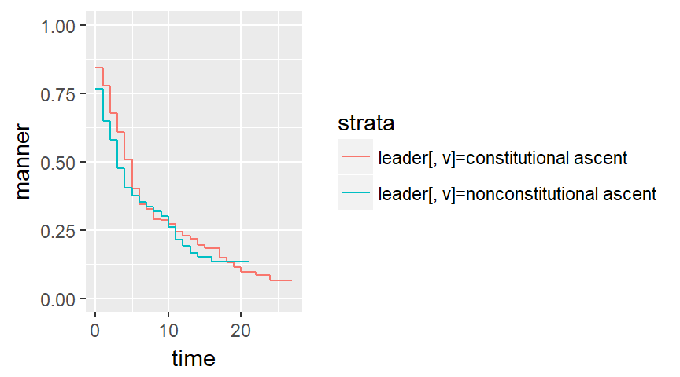
The leader data set, Kaplan-Meier curves

Slide 27
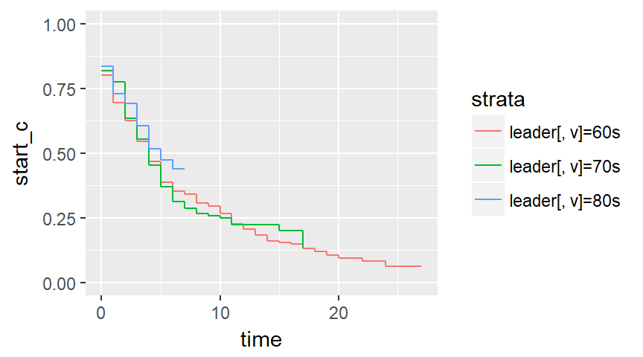
The leader data set, Kaplan-Meier curves

Slide 28
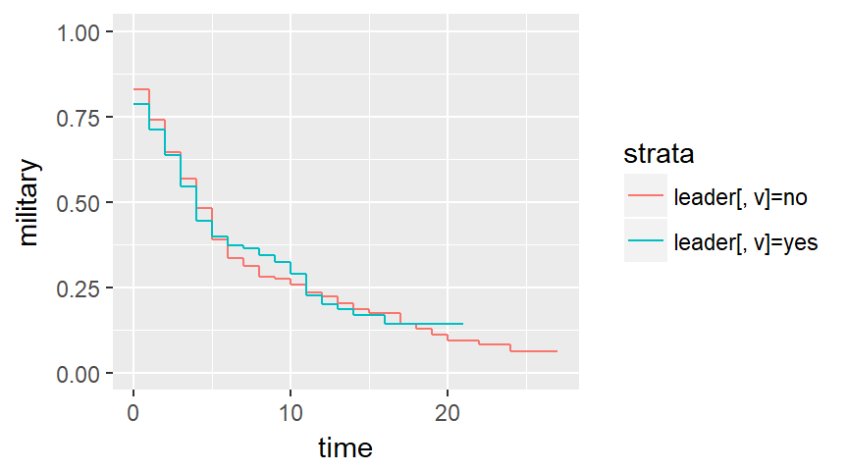
The leader data set, Kaplan-Meier curves

Slide 29
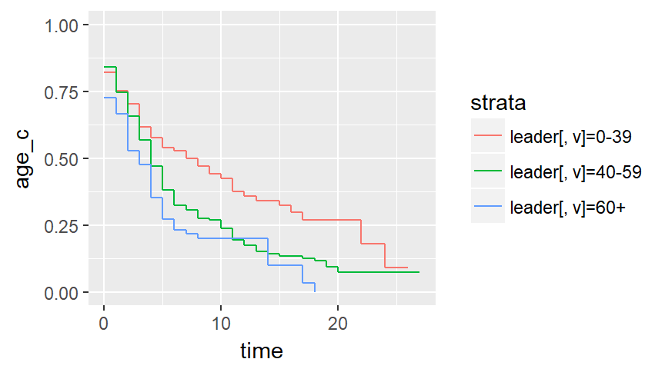
The leader data set, Kaplan-Meier curves

Slide 30
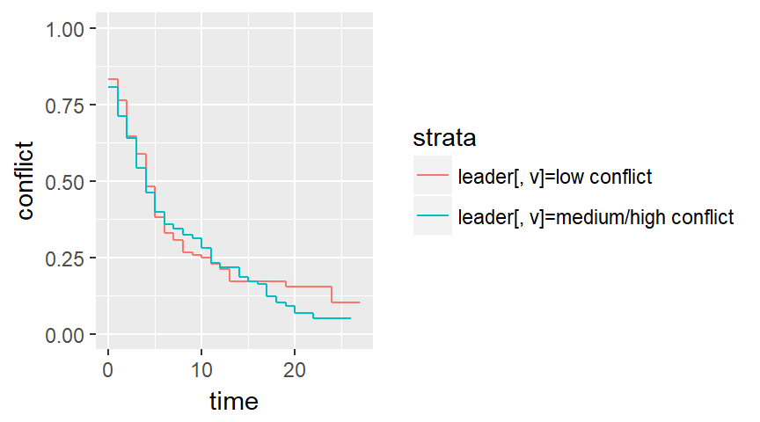
The leader data set, Kaplan-Meier curves

Slide 31
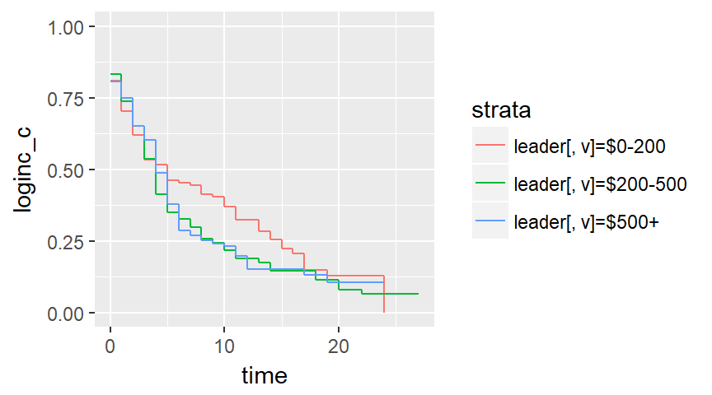
The leader data set, Kaplan-Meier curves

Slide 32
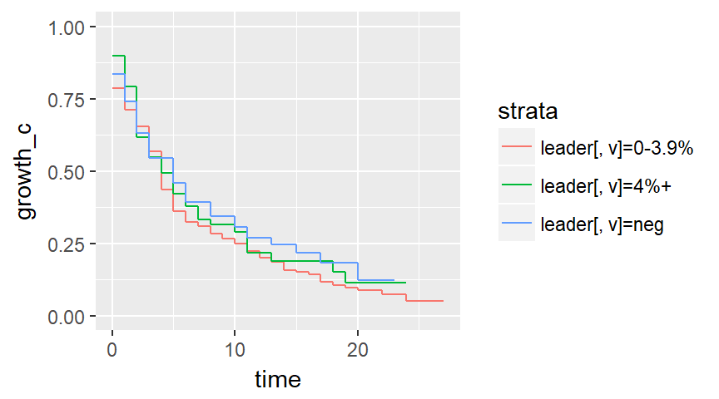
The leader data set, Kaplan-Meier curves

Slide 33
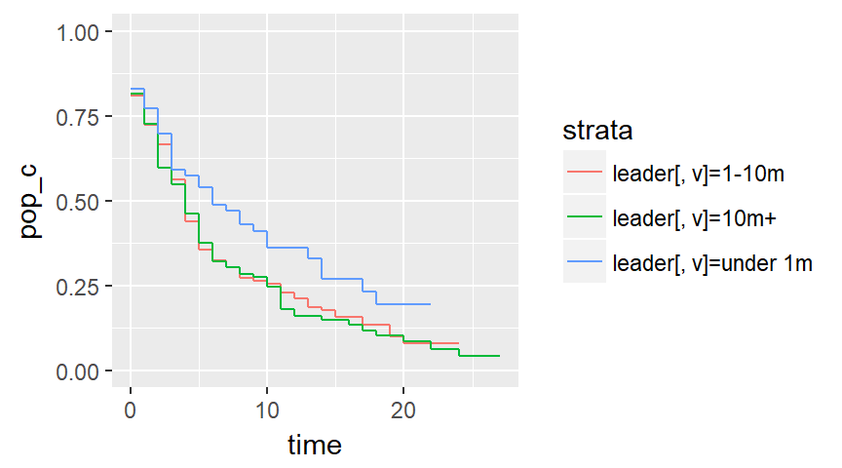
The leader data set, Kaplan-Meier curves

Slide 34
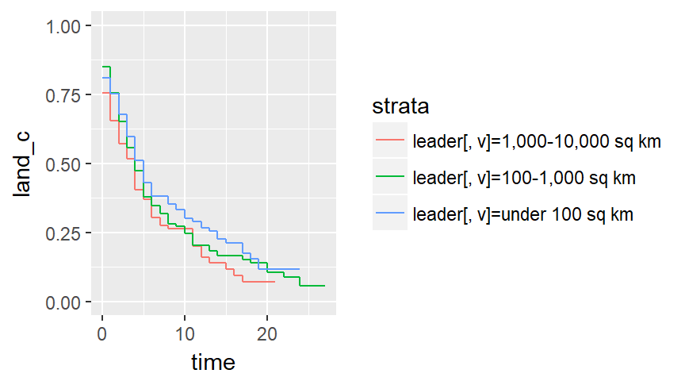
The leader data set, Kaplan-Meier curves

Slide 35
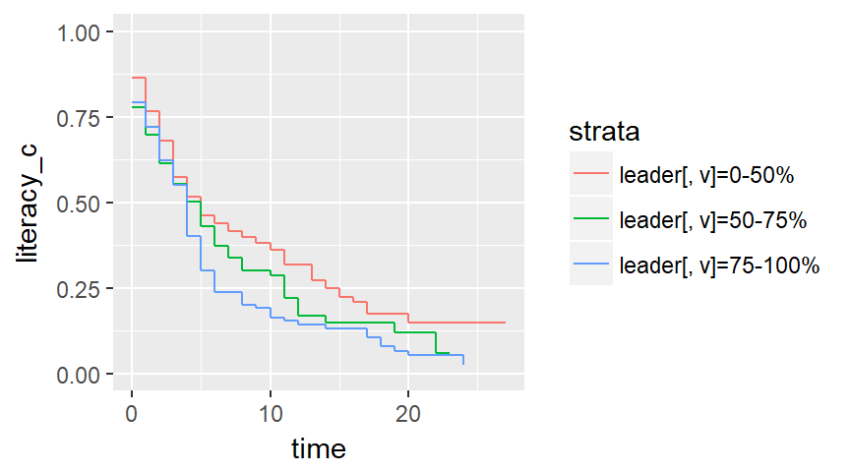
The leader data set, Kaplan-Meier curves

Slide 36
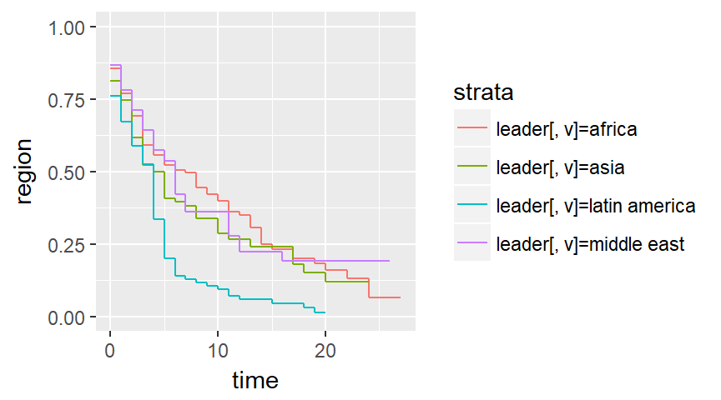
The leader data set, Kaplan-Meier curves

Slide 37
The leader data set
Run univariate Cox models
coef exp(coef) se(coef) z p
manner 0.138 1.148 0.116 1.19 0.23
coef exp(coef) se(coef) z p
military -0.00827 0.99176 0.11949 -0.07 0.94
coef exp(coef) se(coef) z p
age 0.02170 1.02194 0.00482 4.51 6.6e-06

Slide 38
The leader data set
Run a multivariate Cox model
coef exp(coef) se(coef) z p-v
manner 0.359963 1.433277 0.153237 2.349 0.0188
military -0.128457 0.879451 0.157289 -0.817 0.4141
age 0.024148 1.024442 0.004967 4.862 0.0001

Slide 39
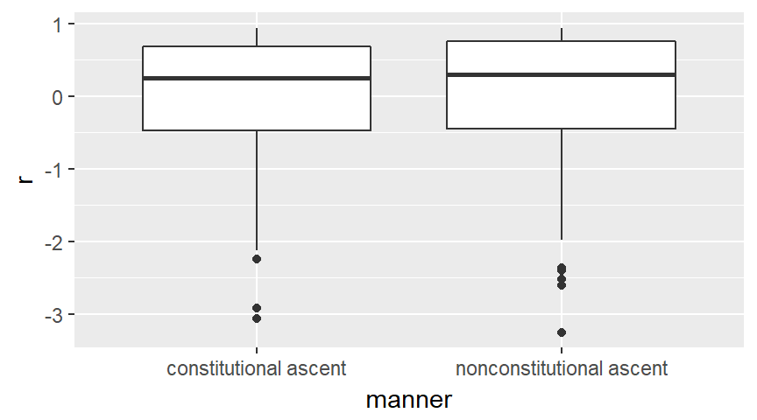
The leader data set, Martingale residuals

Slide 40
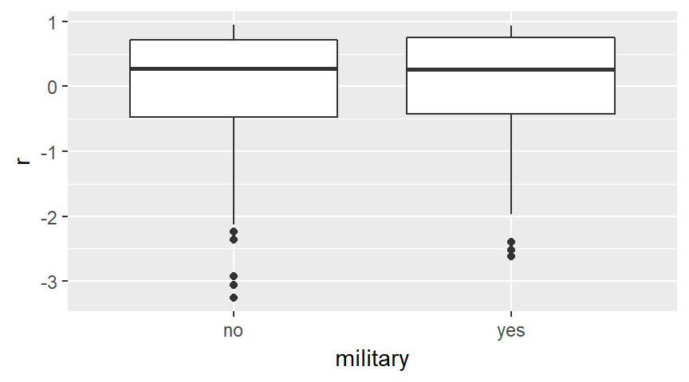
The leader data set, Martingale residuals

Slide 41
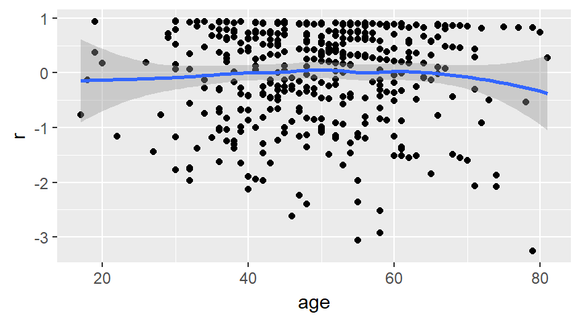
The leader data set, Martingale residuals

Slide 42
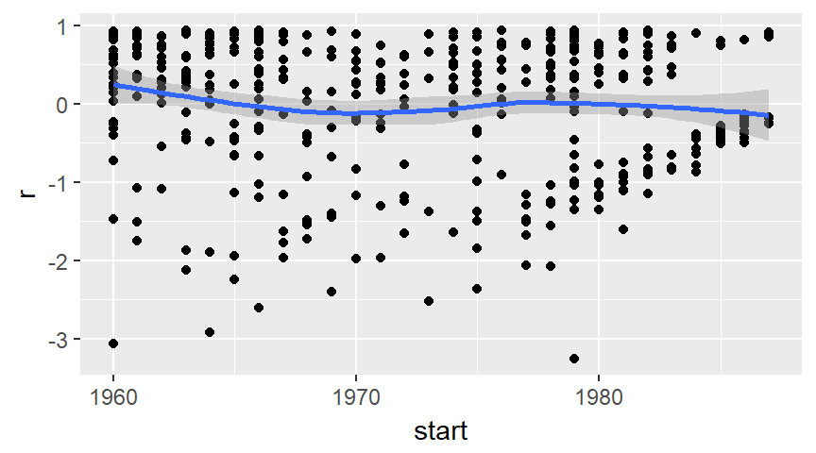
The leader data set, Martingale residuals

Slide 43
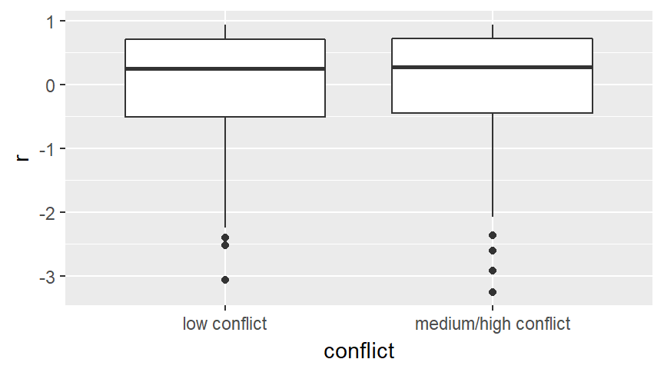
The leader data set, Martingale residuals

Slide 44
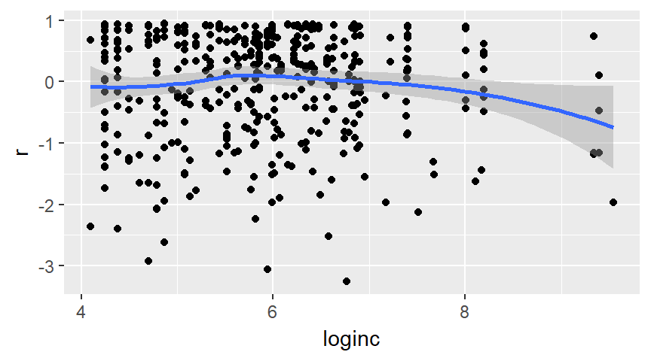
The leader data set, Martingale residuals

Slide 45
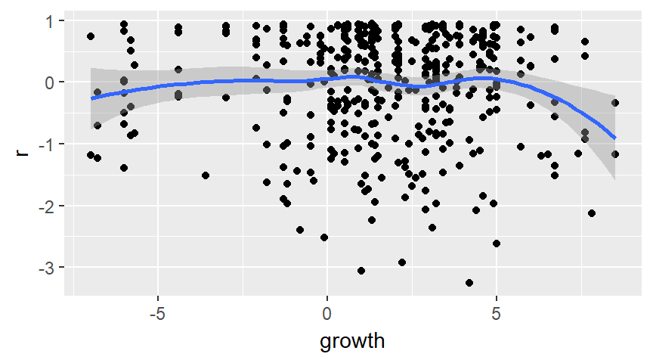
The leader data set, Martingale residuals

Slide 46
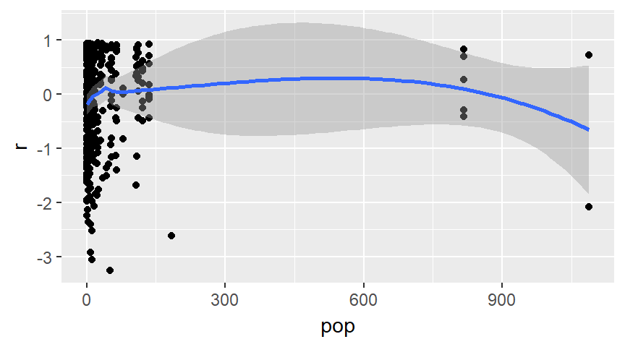
The leader data set, Martingale residuals

Slide 47
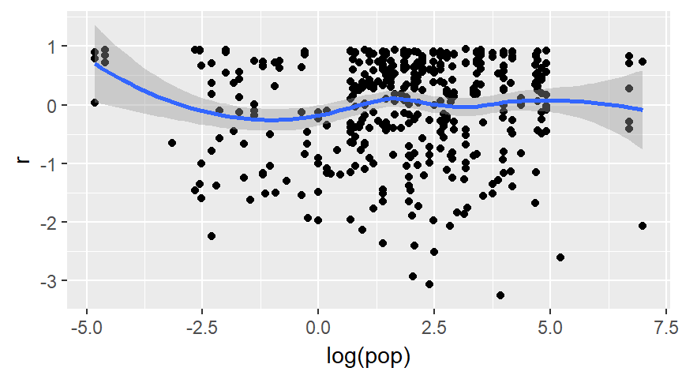
The leader data set, Martingale residuals

Slide 48
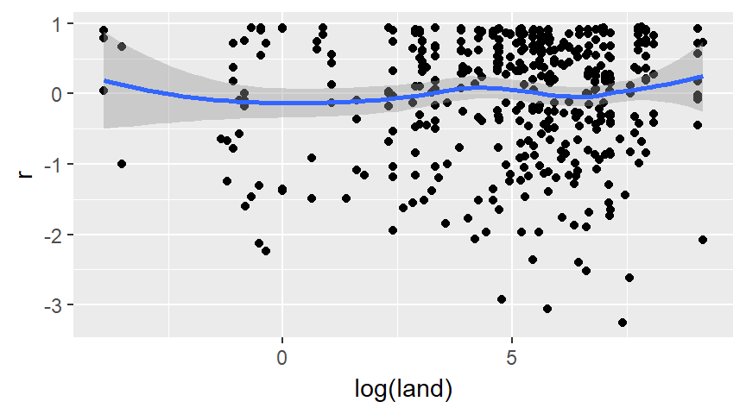
The leader data set, Martingale residuals

Slide 49
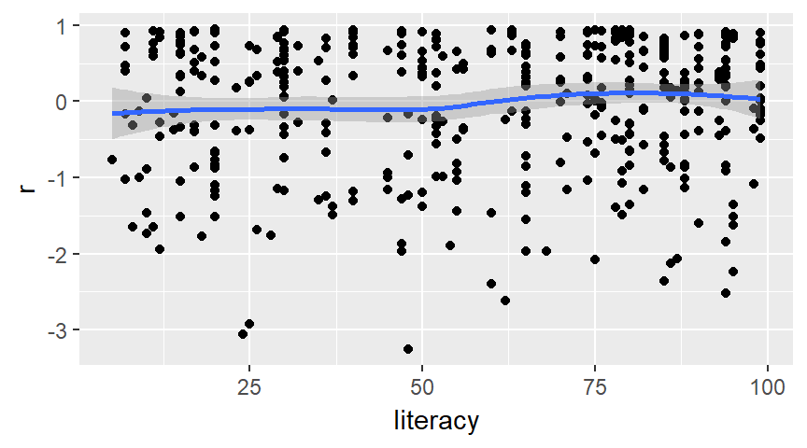
The leader data set, Martingale residuals

Slide 50
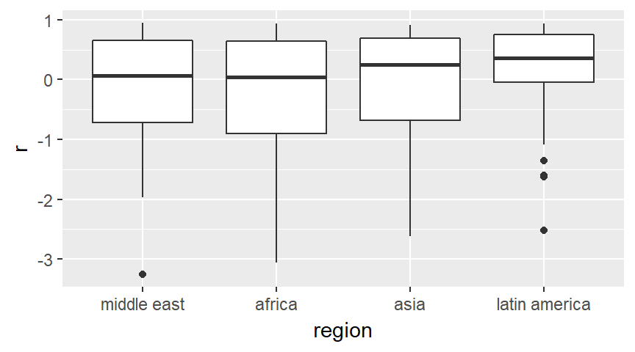
The leader data set, Martingale residuals

Slide 51
The leader data set
Revise your multivariate Cox model
coef exp(coef) se(coef) z Pr(>|z|)
manner 0.34961 1.41851 0.15279 2.288 0.02213
military -0.20673 0.81324 0.15670 -1.319 0.18706
age 0.02230 1.02255 0.00514 4.339 1.43e-05
loginc -0.18795 0.82866 0.07040 -2.670 0.00759
i_africa -0.37780 0.68537 0.21571 -1.751 0.07986
i_asia -0.21214 0.80885 0.22368 -0.948 0.34292
i_lat_am 0.51930 1.68085 0.18143 2.862 0.00421

Slide 52
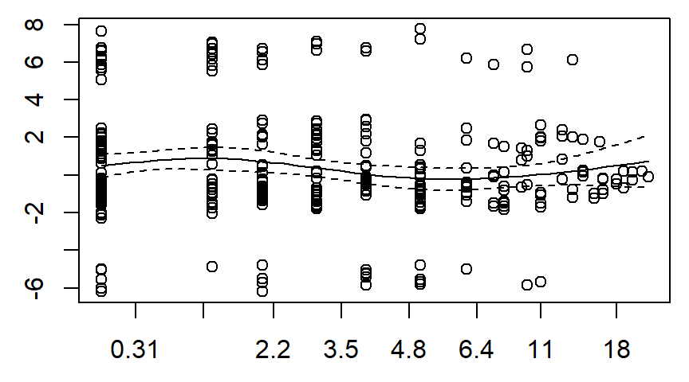
The leader data set, Schoenfeld residuals

Slide 53
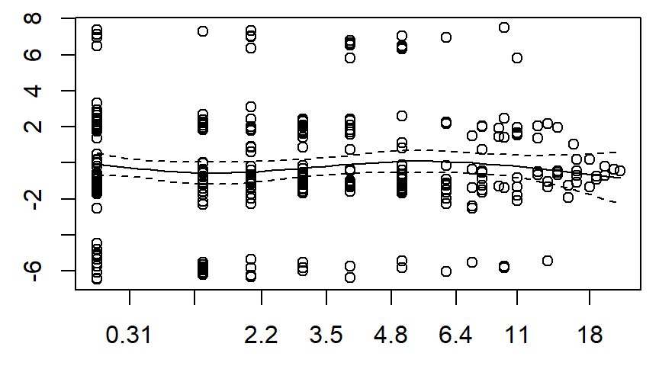
The leader data set, Schoenfeld residuals

Slide 54
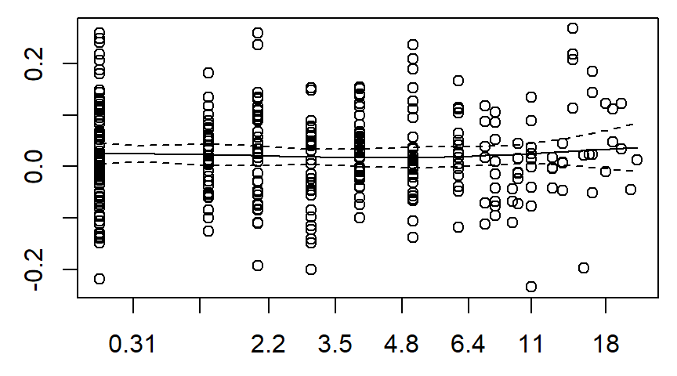
The leader data set, Schoenfeld residuals

Slide 55
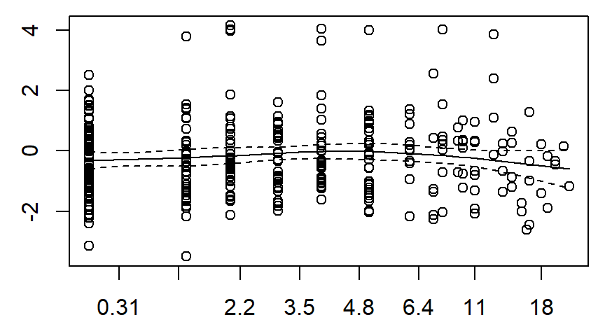
The leader data set, Schoenfeld residuals

Slide 56
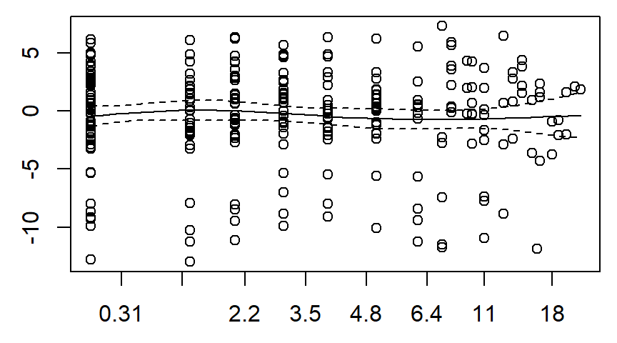
The leader data set, Schoenfeld residuals

Slide 57
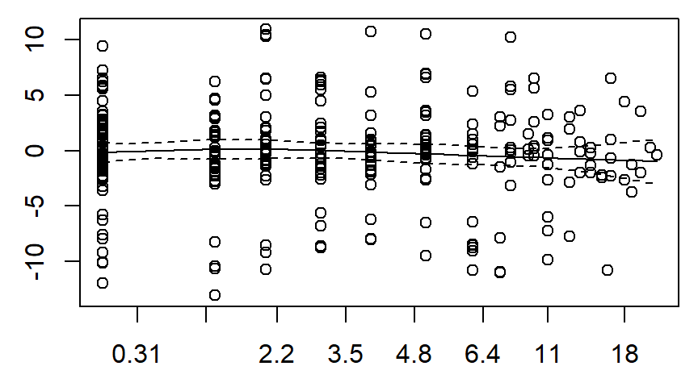
The leader data set, Schoenfeld residuals

Slide 58
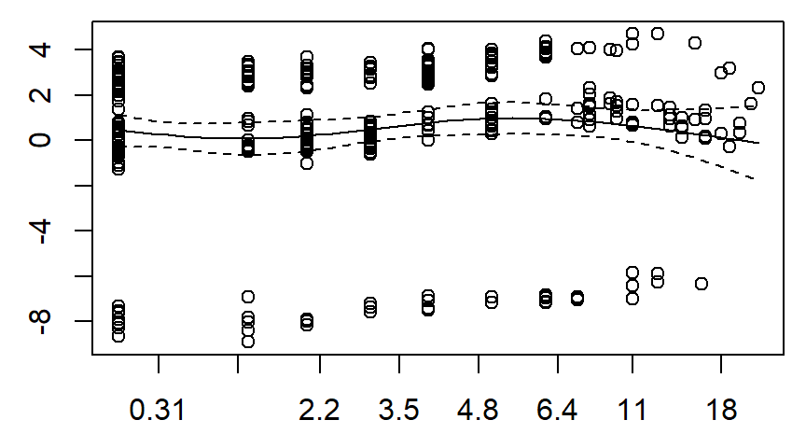
The leader data set, Schoenfeld residuals

Slide 59
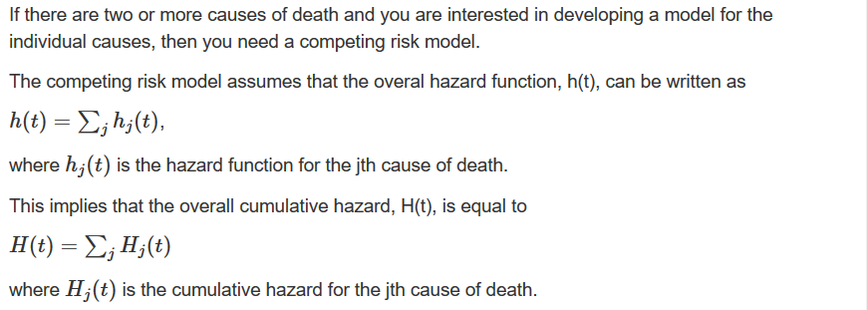
The competing risks model

Slide 60
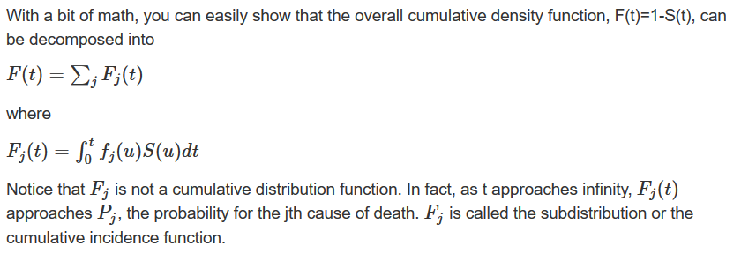
The competing risks model

Slide 61
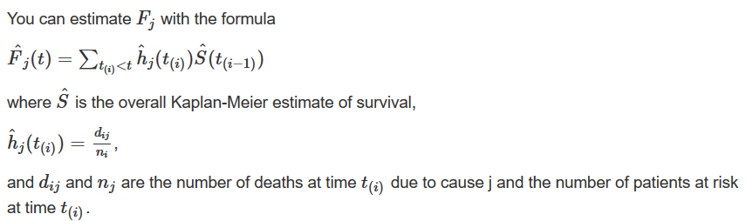
The competing risks model

Slide 62
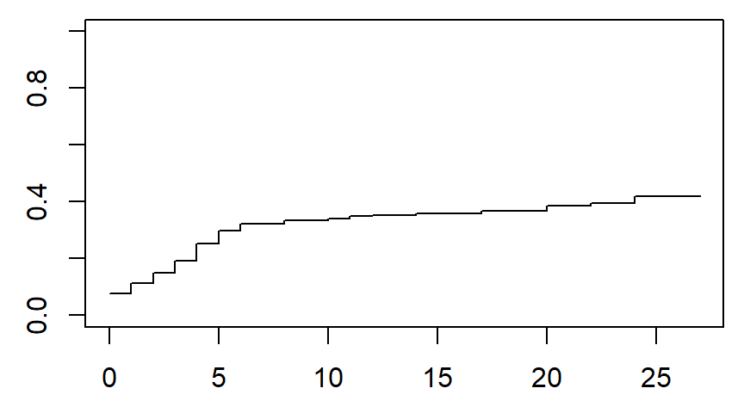
Competing risks, constitutional exit

Slide 63
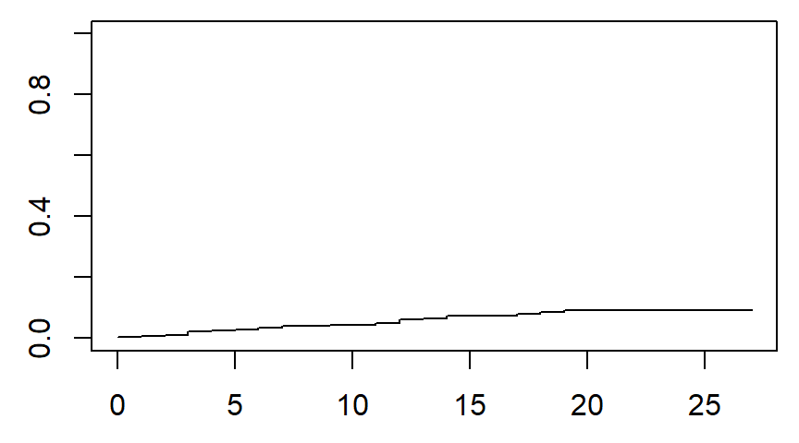
Competing risks, natural death

Slide 64
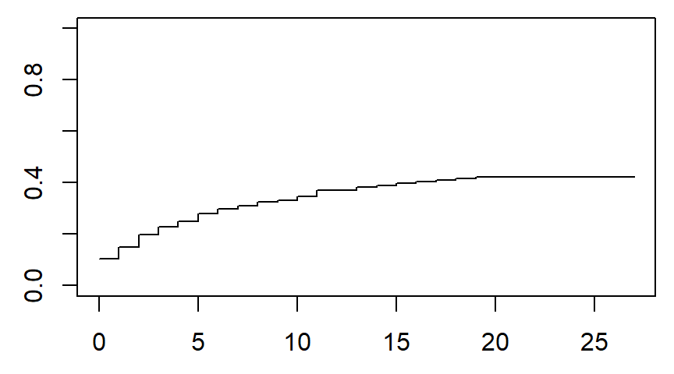
Competing risks, nonconstitutional exit

Slide 65
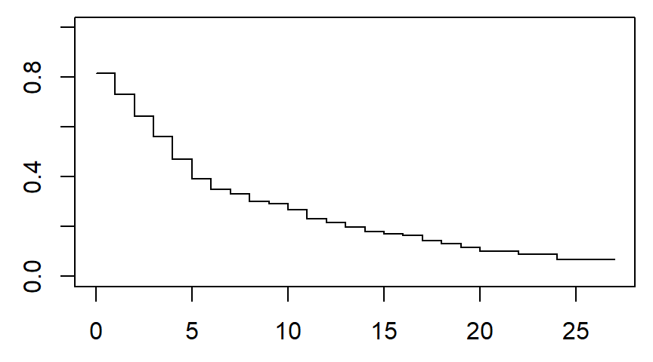
Competing risks, probability of no exit

Slide 66
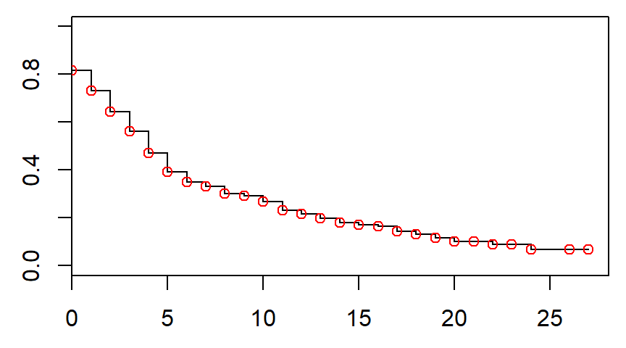
Probability of no exit matches overall survival

Slide 67
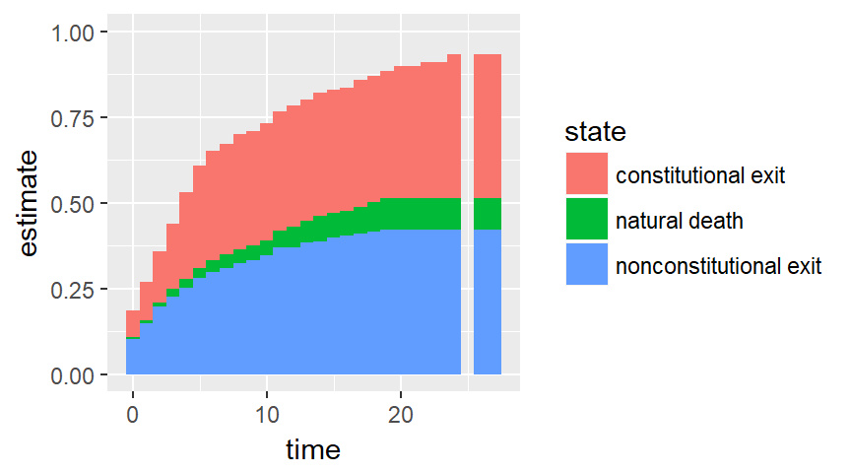
The leader data set, competing risks

Slide 68
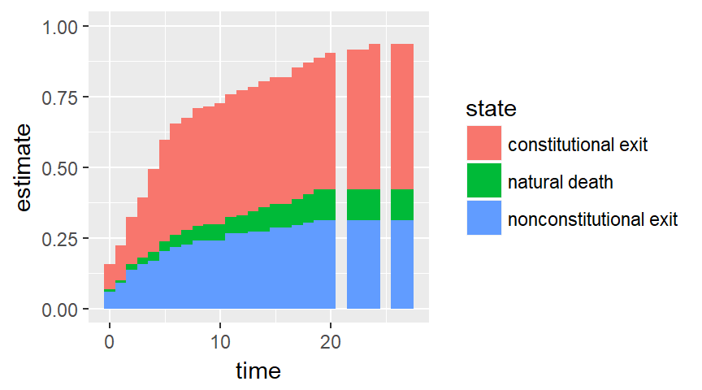
The leader data set, competing risks

Slide 69
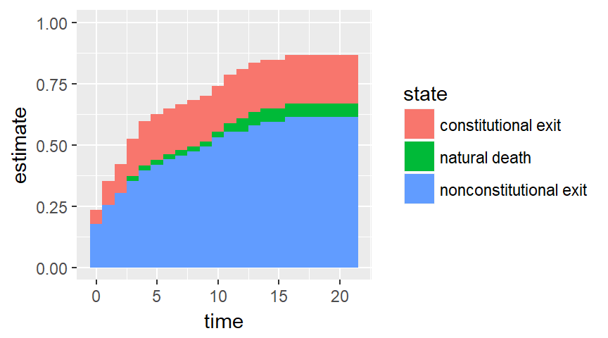
Subgroup nonconstitutional ascent

Slide 70
Conclusion
What have you learned today?
Steps in a typical survival model
Descriptive statistics
Counts
Simple Kaplan-Meier curves
Univariate Cox models
Multivariate Cox models
Martingale residuals
Schoenfeld residuals
Competing risk analysis

